Slide 1
Some recent research on Broad Learning

Slide 2
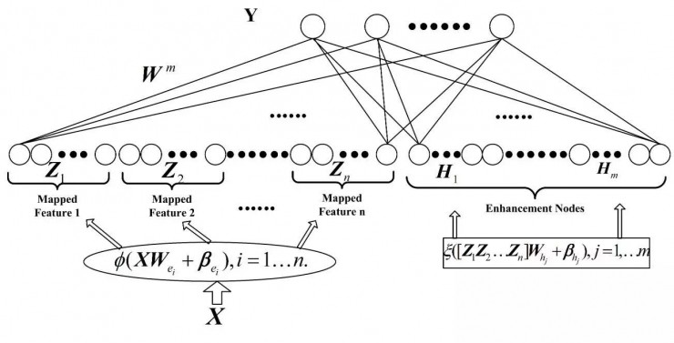
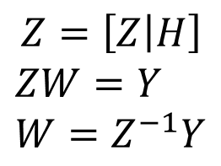
Broad Learning
$$Z=\left[Z | H\right]$$
$$ZW=Y$$
$$W=Z^{−1}Y$$

Slide 3
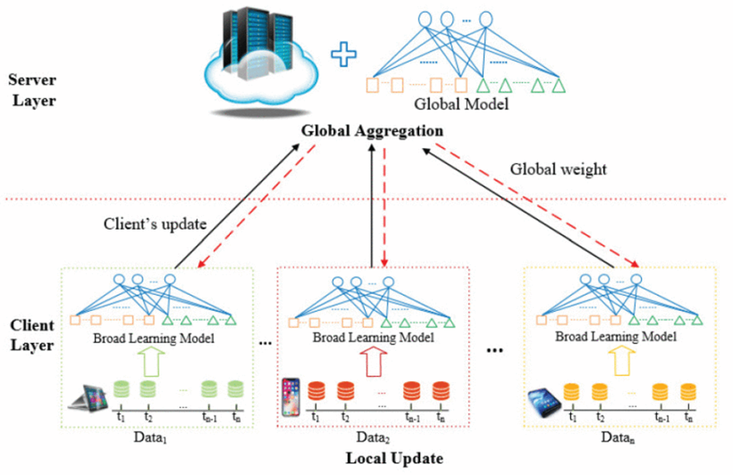
Distributed Broad Learning

Slide 4
Distributed Broad Learning
Data
Training
Trigger satisfied
Client
Local Model
Upload local model
Trigger not satisfied
Incremental learning
Get Global model
CL>T
Force to aggregate

Slide 5
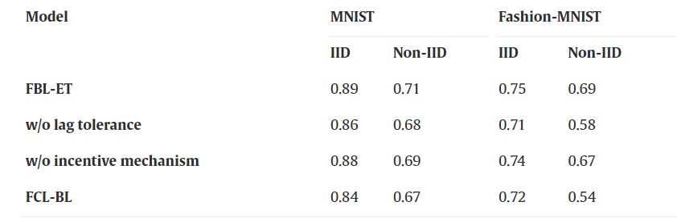
Result

Slide 6
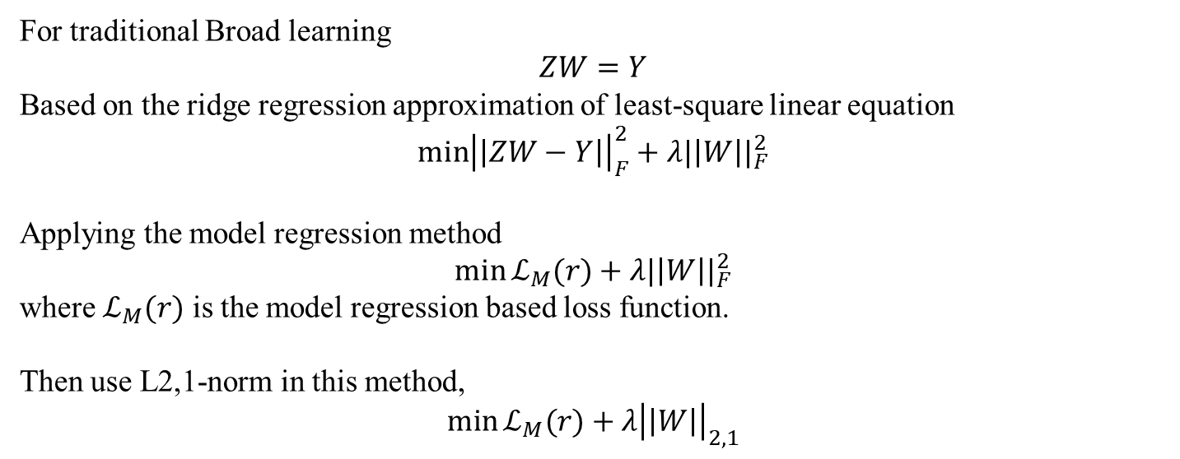
Model-Regression Broad Learning
For traditional Broad learning
$$ZW=Y$$
Based on the ridge regression approximation of least-square linear equation
$$\min{{\left|\left|ZW−Y\right|\right|}_{F}^{2}}+λ{|\left|W\right||}_{F}^{2}$$
Applying the model regression method
$$\min{ℒ_{M}(r)}+λ{|\left|W\right||}_{F}^{2}$$
where $ℒ_{M}(r)$ is the model regression based loss function.
Then use L2,1-norm in this method,
$$\min{ℒ_{M}(r)}+λ{\left|\left|W\right|\right|}_{2,1}$$

Slide 7
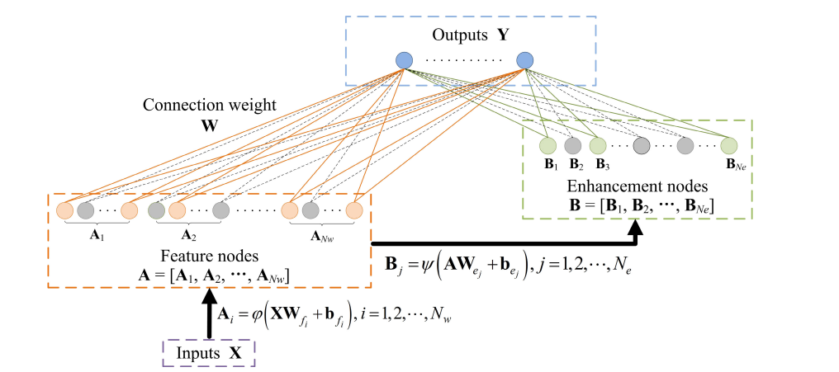
Model-Regression Broad Learning

Slide 8
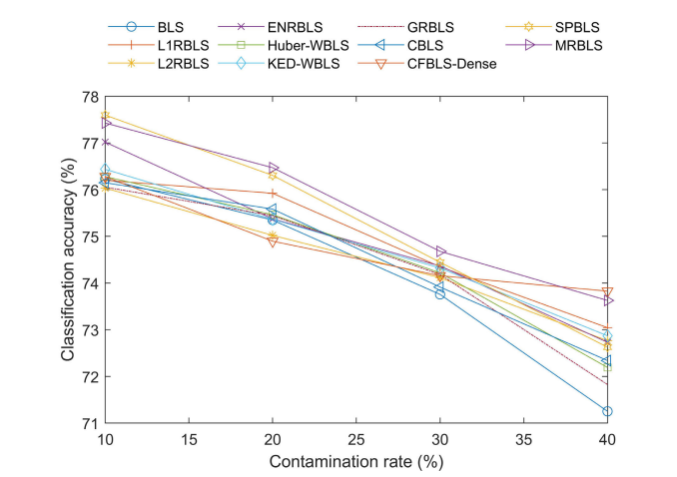
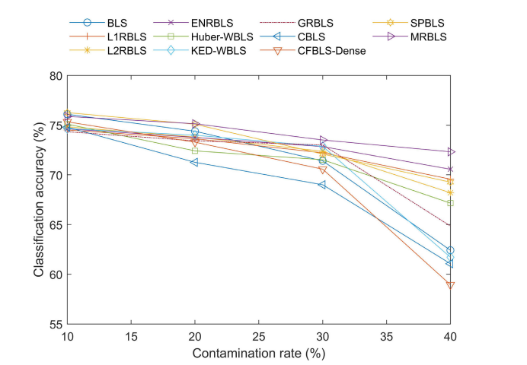
Model-Regression Broad Learning
The accuracy on the Diabetes dataset with different
contamination rates.
The accuracy on the German dataset with different contamination rates

